Slide 1
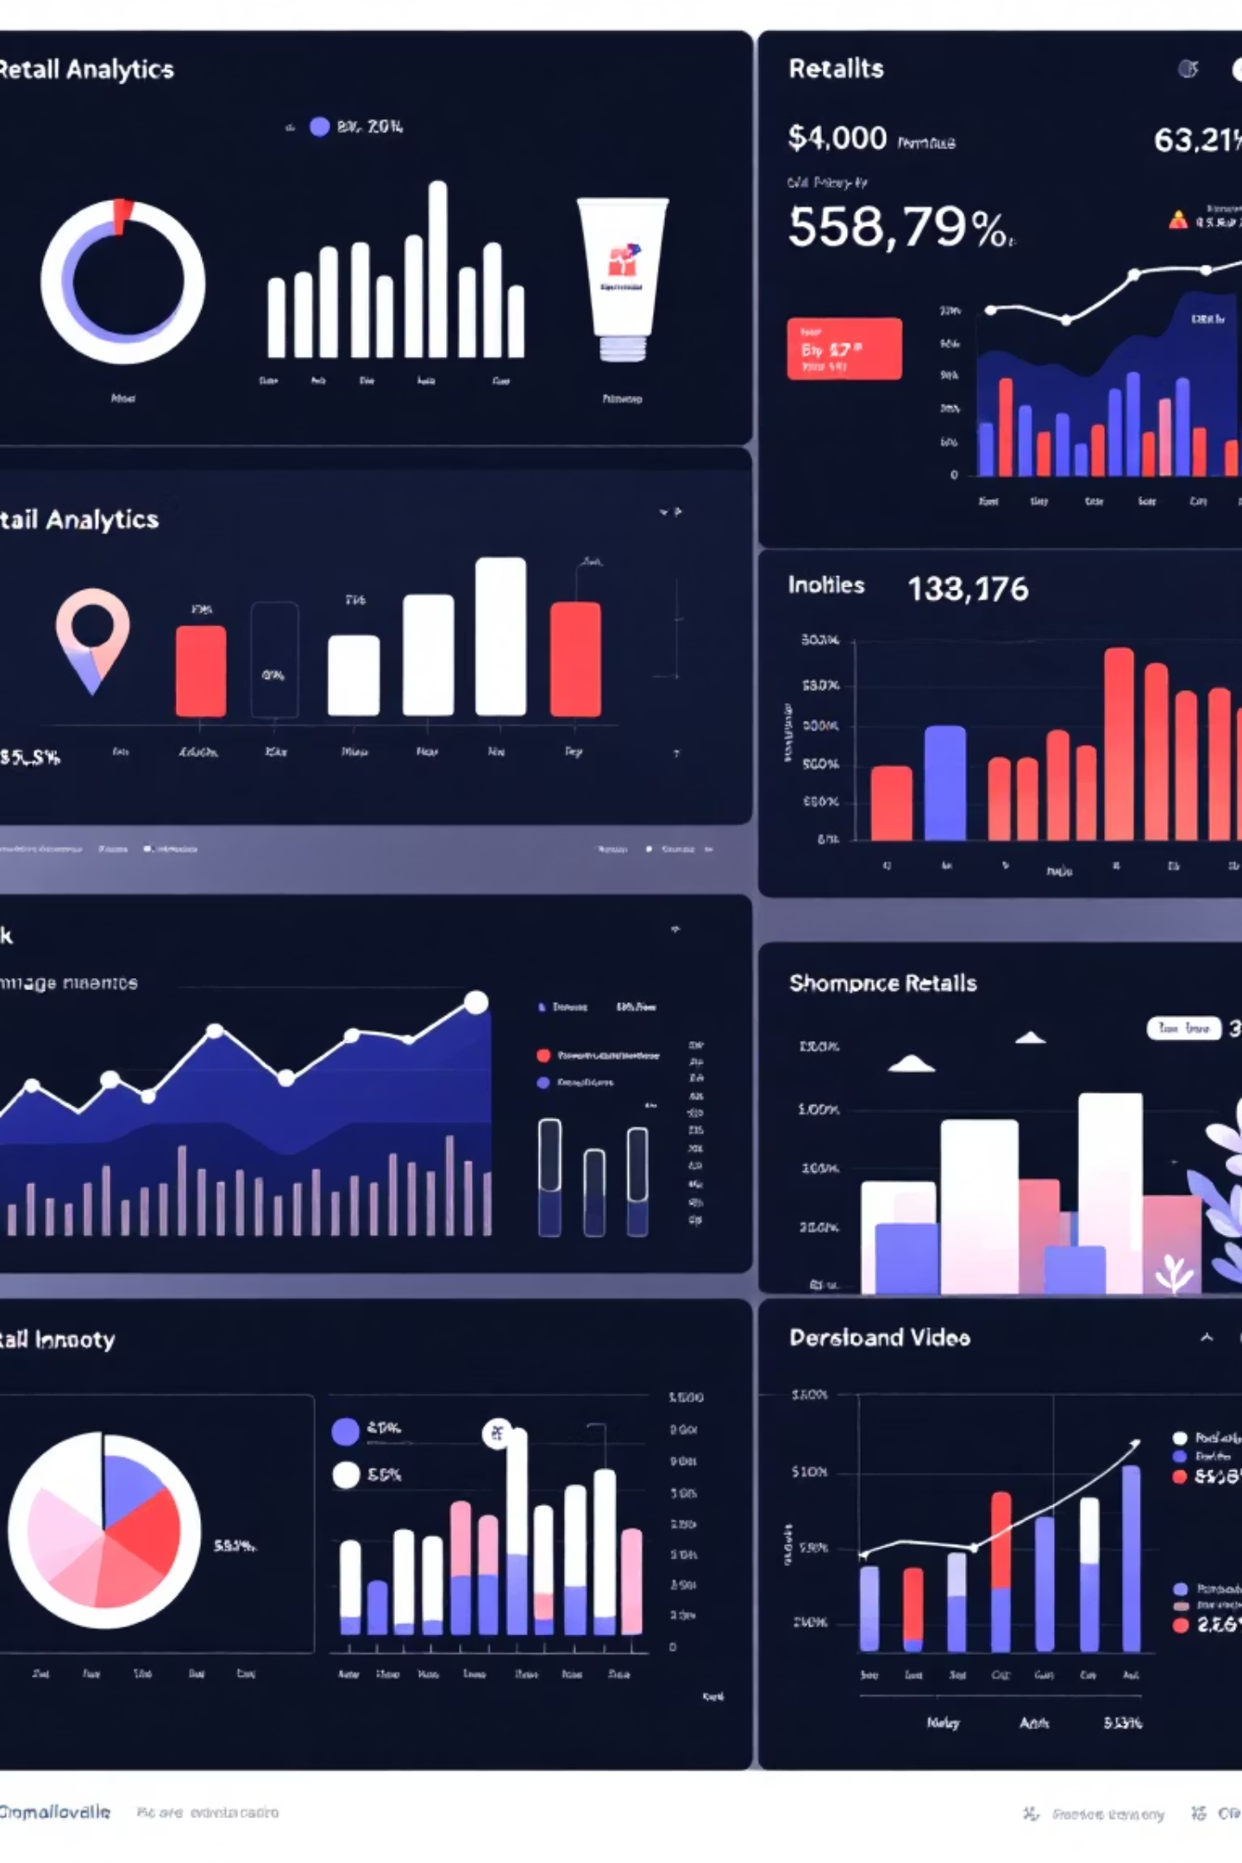
Customer Shopping Trends Analysis
A comprehensive exploration of 3,900 customer transactions revealing key insights into purchasing behavior, preferences, and trends across demographics and seasons.

Slide 2

Dataset Overview
3,900
18
0
0
Total Transactions
Data Attributes
Missing Values
Duplicates
Complete customer purchase records analyzed
Comprehensive variables tracked per transaction
Clean dataset with no null entries
No duplicate records found
The dataset spans 50 locations across the US, tracking purchases across 4 product categories with 25 unique items. Customer ages range from 18 to 70 years, with an average age of 44.

Slide 3

Customer Demographics
Gender Distribution
The customer base shows a significant gender skew:
Male customers: 2,652 (68%)
Female customers: 1,248 (32%)
This 2:1 ratio suggests potential opportunities for targeted marketing campaigns to balance the customer base.
Age Profile
Average customer age is 44 years, with a standard deviation of 15.2 years, indicating a broad age range from young adults to seniors.

Slide 4

Purchase Behavior Insights
Average Purchase
Previous Purchases
$59.76 per transaction
25.4 average transactions
Range: $20 - $100
Range: 1 - 50 purchases
Review Rating
3.75 out of 5.0
Range: 2.5 - 5.0 stars

Slide 5
Product Category Performance
1
2
Clothing
Footwear
1,737 purchases (44.5% of total)
Second highest category
Average spend: $60.03
Average spend: $60.26
Most popular category with items like blouses, jeans, and sweaters
Highest average purchase amount across all categories
3
4
Accessories
Outerwear
Third most popular
Smallest category
Includes handbags, scarves, and belts
Seasonal demand patterns observed

Slide 6





Seasonal Shopping Patterns
Spring
Winter
$58,679 total revenue
$58,607 total revenue
25.2% of annual sales
25.2% of annual sales
Highest review rating: 3.79
Fall
Summer
$60,018 total revenue
$55,777 total revenue
25.8% of annual sales
24.0% of annual sales
Peak shopping season
Lowest seasonal performance
Seasonal distribution is remarkably balanced, with Fall leading slightly. Spring customers show highest satisfaction with 3.79 average rating.

Slide 7
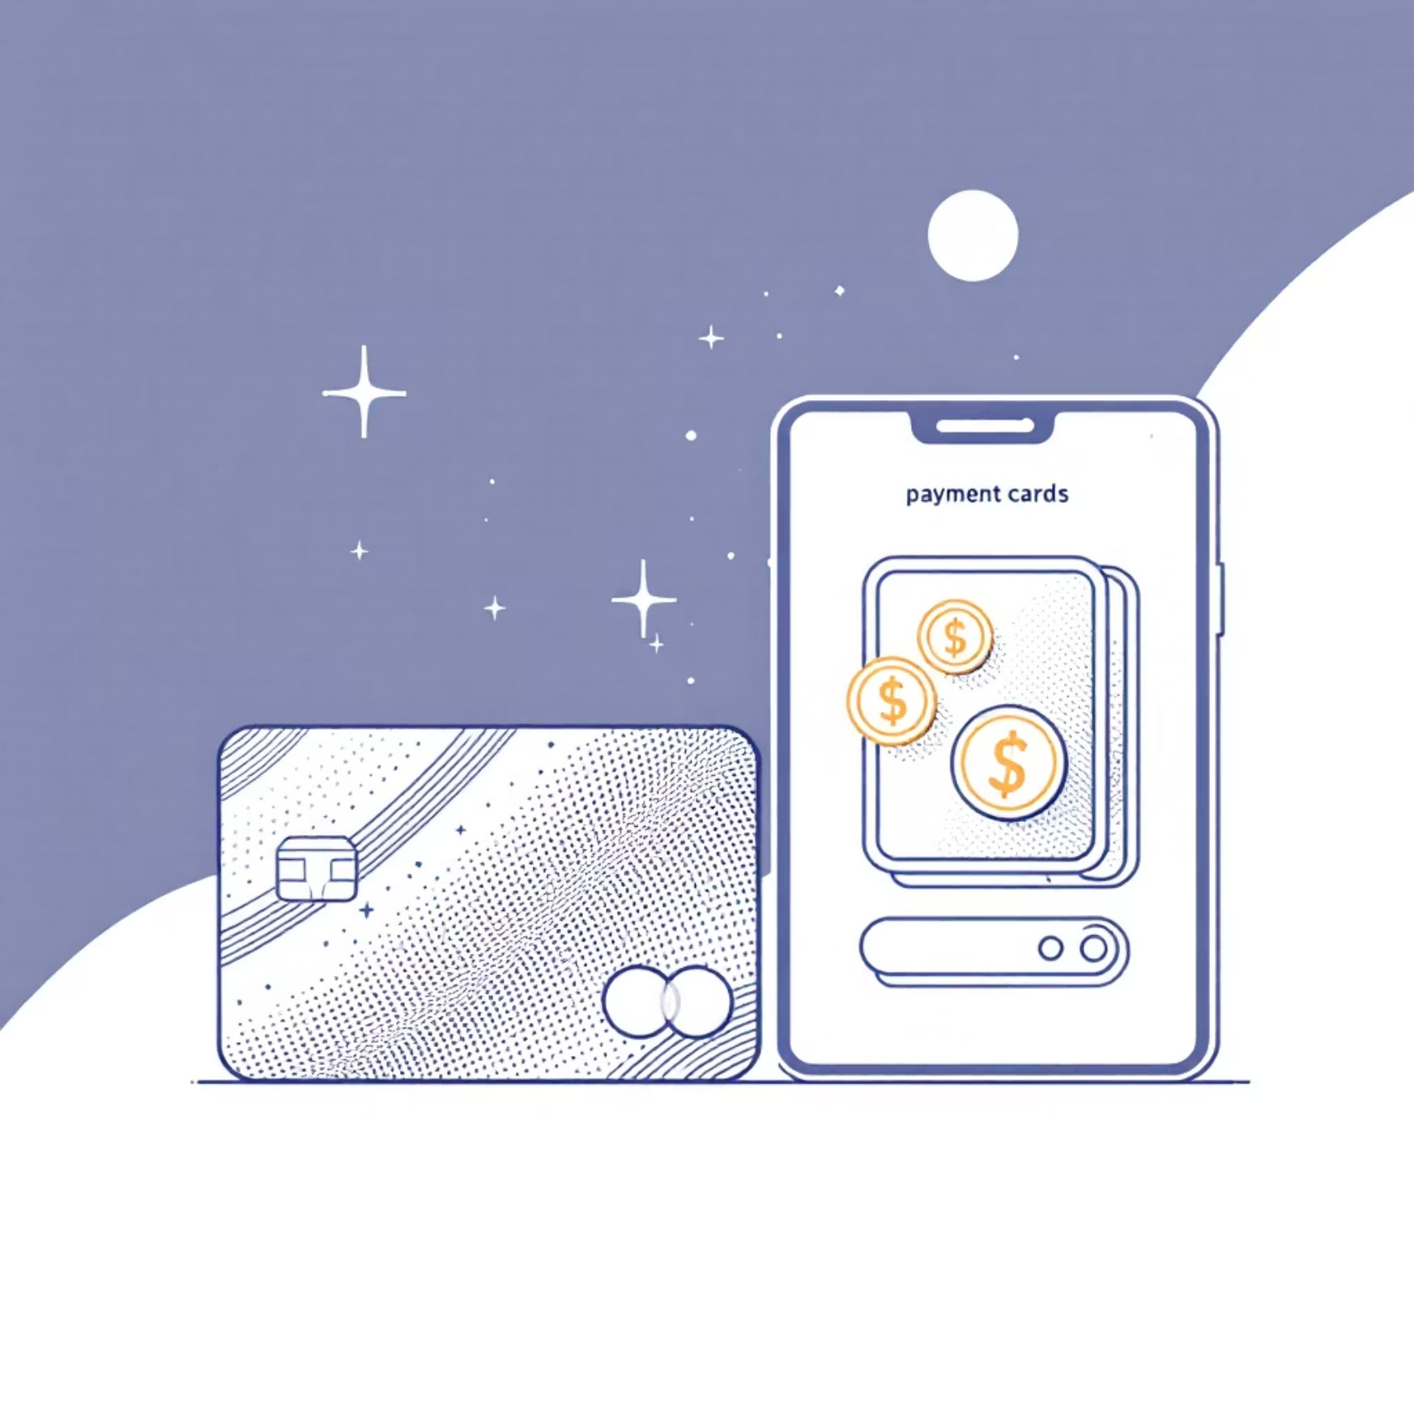
Payment & Subscription Trends
Payment Methods
Subscription Status
Total revenue by payment type:
73% of customers are not subscribed (2,847 customers)
Credit Card: $42,567 (18.3%)
Only 27% maintain active subscriptions, representing a significant growth opportunity for recurring revenue.
Venmo: $39,991 (17.2%)
Cash: $38,833 (16.7%)
PayPal: $37,449 (16.1%)
Bank Transfer: $37,123 (16.0%)
Debit Card: $37,118 (15.9%)
Bank Transfer is the least preferred method with only 612 users.

Slide 8
Purchase Frequency Analysis
Weekly
1
Most frequent shoppers
Median: 26 previous purchases
2
Fortnightly
Regular customers
Every 3 Months
3
Median: 26 previous purchases
584 customers (most common)
Median: 24 previous purchases
4
Quarterly
Seasonal shoppers
Annually
5
Median: 28 previous purchases
Occasional buyers
Median: 24 previous purchases
Purchase frequency shows diverse customer engagement patterns. Quarterly shoppers have the highest median previous purchases (28), suggesting strong loyalty despite lower frequency.

Slide 9
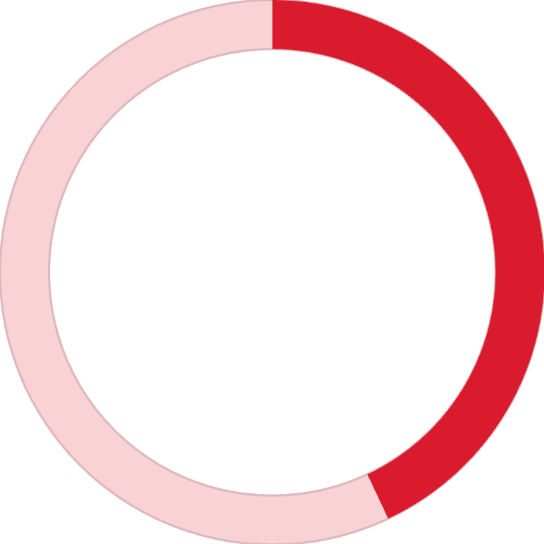
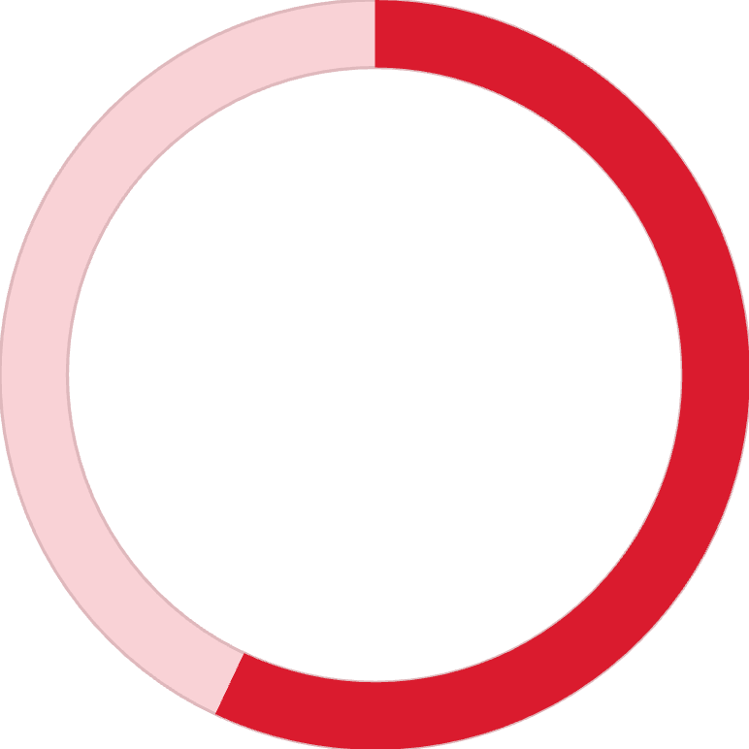

Promotions & Discounts Impact
43%
57%
43%
Discount Applied
No Discount
Promo Code Used
1,677 transactions received discounts
2,223 full-price purchases
Equal split with discount application
Average rating: 3.74
Average rating: 3.76
Key Finding: Discounts show minimal impact on review ratings (3.74 vs 3.76), suggesting customers value product quality over price reductions. Gender analysis reveals no significant rating differences between male and female customers.

Slide 10




Strategic Recommendations
Expand Female Customer Base
With only 32% female customers, targeted marketing campaigns could unlock significant growth potential in this underserved segment.
Boost Subscription Adoption
73% non-subscription rate presents major opportunity. Implement incentive programs to convert one-time buyers into subscribers.
Optimize Seasonal Strategies
Leverage Fall's peak performance and address Summer's lower sales with targeted promotions and seasonal product launches.
Diversify Payment Options
Promote underutilized payment methods like Bank Transfer while maintaining strong credit card and digital wallet support.

